Slide 1


International Standards of Actuarial Practice (ISAPs)
Pracovní skupina aktuárská
18. 6. 2020
Petr Bohumský

Slide 2


https://www.actuaries.org/iaa/IAA/Publications/ISAPs/IAA/Publications/05ISAPs.aspx?hkey=334b21a7-a3ac-4e0e-8294-3cbc755ab14a

Slide 3
Základní principy
The IAA develops International Standards of Actuarial Practice (ISAPs) which are model standards of practice.
The IAA encourages its member associations to have in place standards of practice that are substantially consistent with these standards.
ISAPs are model standards of actuarial practice and, as such, are not binding on any actuary.

Slide 4
ISAP 1 – General Actuarial Practice
ISAP 1A – Governance of Models
ISAP 2 – Financial Analysis of Social Security Programs
ISAP 3 – IAS 19 Employee Benefits
ISAP 4 – IFRS 17 Insurance Contracts
ISAP 5 – Insurer Enterprise Risk Models
ISAP 6 – Enterprise Risk Management Programs and IAIS Insurance Core Principles
Glossary

Slide 5
Development History
2019
ISAP 4 – IFRS 17 Insurance Contracts
Conformance Changes - ISAP 2, ISAP 3 and ISAP 5
ISAP 1 – Review
ISAP 6 – Enterprise Risk Management Programs and IAIS Insurance Core Principles
Conformance Changes – ISAP 1, ISAP 2 and ISAP 3
ISAP 1 – General Actuarial Practice
ISAP 1A – Governance of Models
ISAP 5 – Insurer Enterprise Risk Models
ISAP 3 – IAS19 Employee Benefits
ISAP 2 – Financial Analysis of Social Security Programs
2018
2017
2016
2015
2013
2012

Slide 6
ISAP 1 – General Actuarial Practice
ISAP 1A – Governance of Models
This ISAP provides guidance to actuaries when performing actuarial services to give intended users confidence that
  Actuarial services are carried out professionally and with due care;
  The results are relevant to their needs, are presented clearly and understandably, and are complete; and
  The assumptions and methodology (including, but not limited to, models and modelling techniques) used are disclosed appropriately

Slide 7
ISAP 2 – Financial Analysis of Social Security Programs
This International Standard of Actuarial Practice applies to actuarial services performed in the context of social security programs (SSPs).
Because of their significant expertise in preparing long-term financial projections, actuaries often play an important role in carrying out financial analyses of SSPs.
Due to the reliance placed on actuarial projections in public policy decision-making, it is important that the short- and long-term demographic and economic analyses of these SSPs provide objectively-prepared projections of their future conditions.

Slide 8
ISAP 3 – IAS 19 Employee Benefits
The reporting entity is responsible for all the information reported in its IFRS financial statements, including information reported in accordance with IAS 19.
In practice, an actuary may advise on a range of issues arising from the application of IAS 19, including the measurement of short-term, post-employment, termination, or other long-term employee benefits and disclosures in the IFRS financial statements.

Slide 9
ISAP 4 – IFRS 17 Insurance Contracts
An entity which reports financial statements under IFRS is responsible for the information reported.This means it is responsible for, amongst other things, identification, combination, aggregation, separation, recognition and derecognition of contracts, the choice of measurement approach and assumptions, the measurement calculations and the disclosures in the IFRS financial statements.
Nevertheless, actuaries providing actuarial services in connection with IFRS 17 may be advising the entity on decisions, carrying out the calculations required or some combination of these.

Slide 10
ISAP 5 – Insurer Enterprise Risk Models
Actuaries play a principal role in assuring financial soundness of insurers, and their approach often includes the use of enterprise risk models.
Increasingly, boards and senior managers of insurers rely on enterprise risk modelling for both regulatory and management decision-making purposes.
As a result, insurers, their stakeholders, and other interested parties have a strong interest in the reliable operation and transparent governance of the use of enterprise risk models.
As employees or advisors, actuaries play an important role in advising insurers and others on the development or selection of the appropriate models and the related testing, validation, and interpretation of the outcomes.

Slide 11
ISAP 6 – Enterprise Risk Management Programs and IAIS Insurance Core Principles
ERM programs include processes undertaken by insurers to identify, assess, measure, control, mitigate, monitor and communicate on risks in respect of the insurance enterprise.
These programs have come to be seen by insurance supervisors globally as a critical activity of insurers.
The IAIS has recognized the importance of ERM programs in two of the Insurance Core Principles (ICPs): ICP 8 Risk Management and Internal Controls and ICP 16 Enterprise Risk Management for Solvency Purposes.
Depending on the level of sophistication, insurers’ approaches to risk management may range from simple consideration of the adequacy of current financial resources to integrated holistic consideration and management of a wide range of risks.
Many actuaries perform actuarial services in connection with ERM programs, including acting as an employee of an insurer, as an independent professional, as part of an external audit team or as a supervisor of insurers.
In some jurisdictions, actuaries are called upon to give a professional opinion regarding the ERM program to the supervisor.

Slide 12
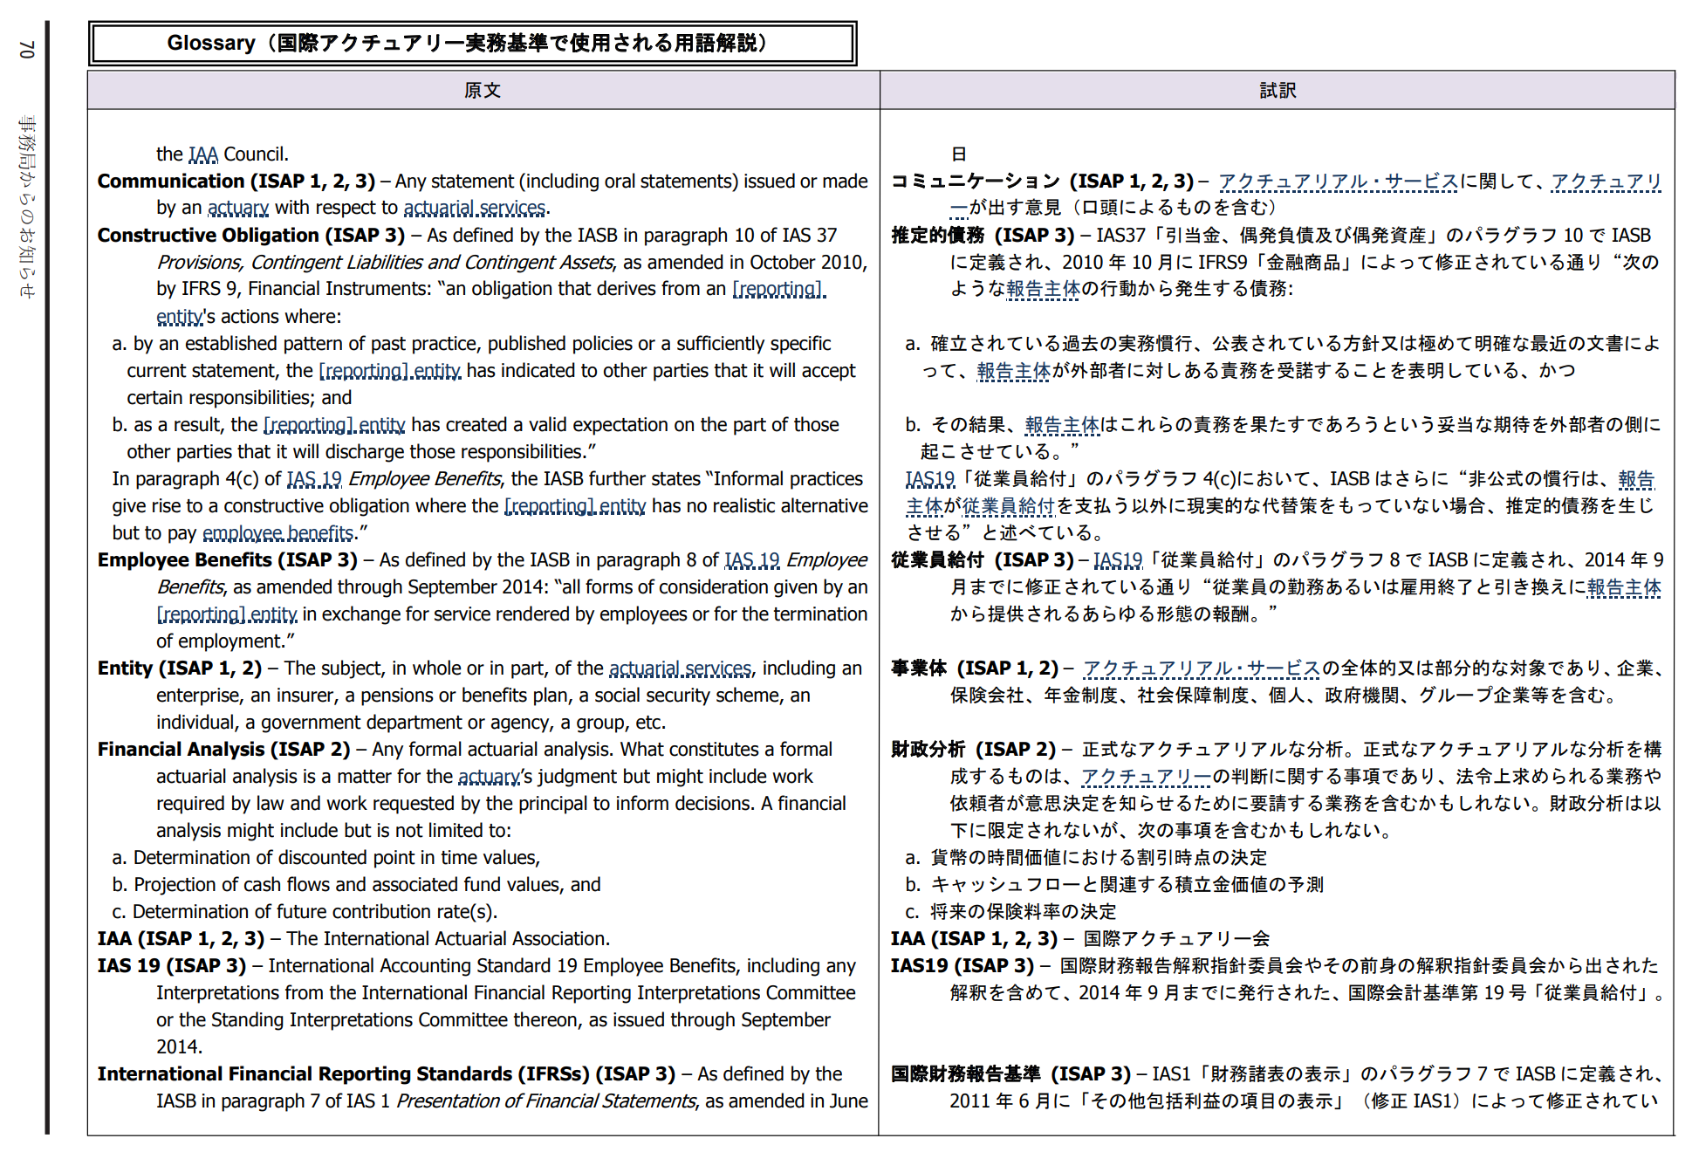

Slide 13
ISAP 1 – General Actuarial Practice
ISAP 1A – Governance of Models
ISAP 2 – Financial Analysis of Social Security Programs
ISAP 3 – IAS 19 Employee Benefits
ISAP 4 – IFRS 17 Insurance Contracts
ISAP 5 – Insurer Enterprise Risk Models
ISAP 6 – Enterprise Risk Management Programs and IAIS Insurance Core Principles
Glossary

Slide 14
Petr Bohumský
petr.bohumsky@generaliceska.cz

